Slide 1
Formal Verification of RL-based Approaches

Slide 2
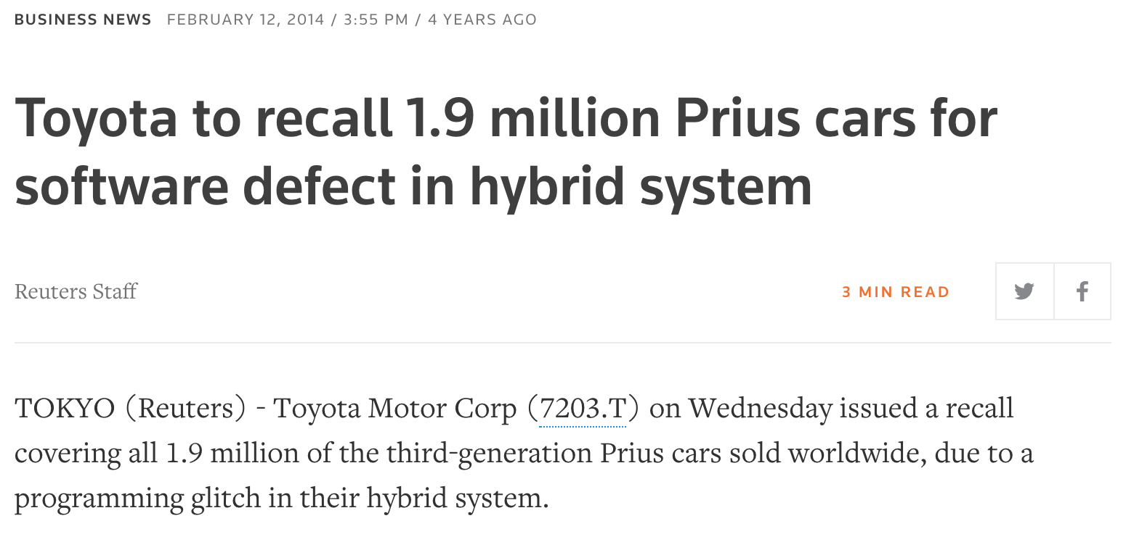
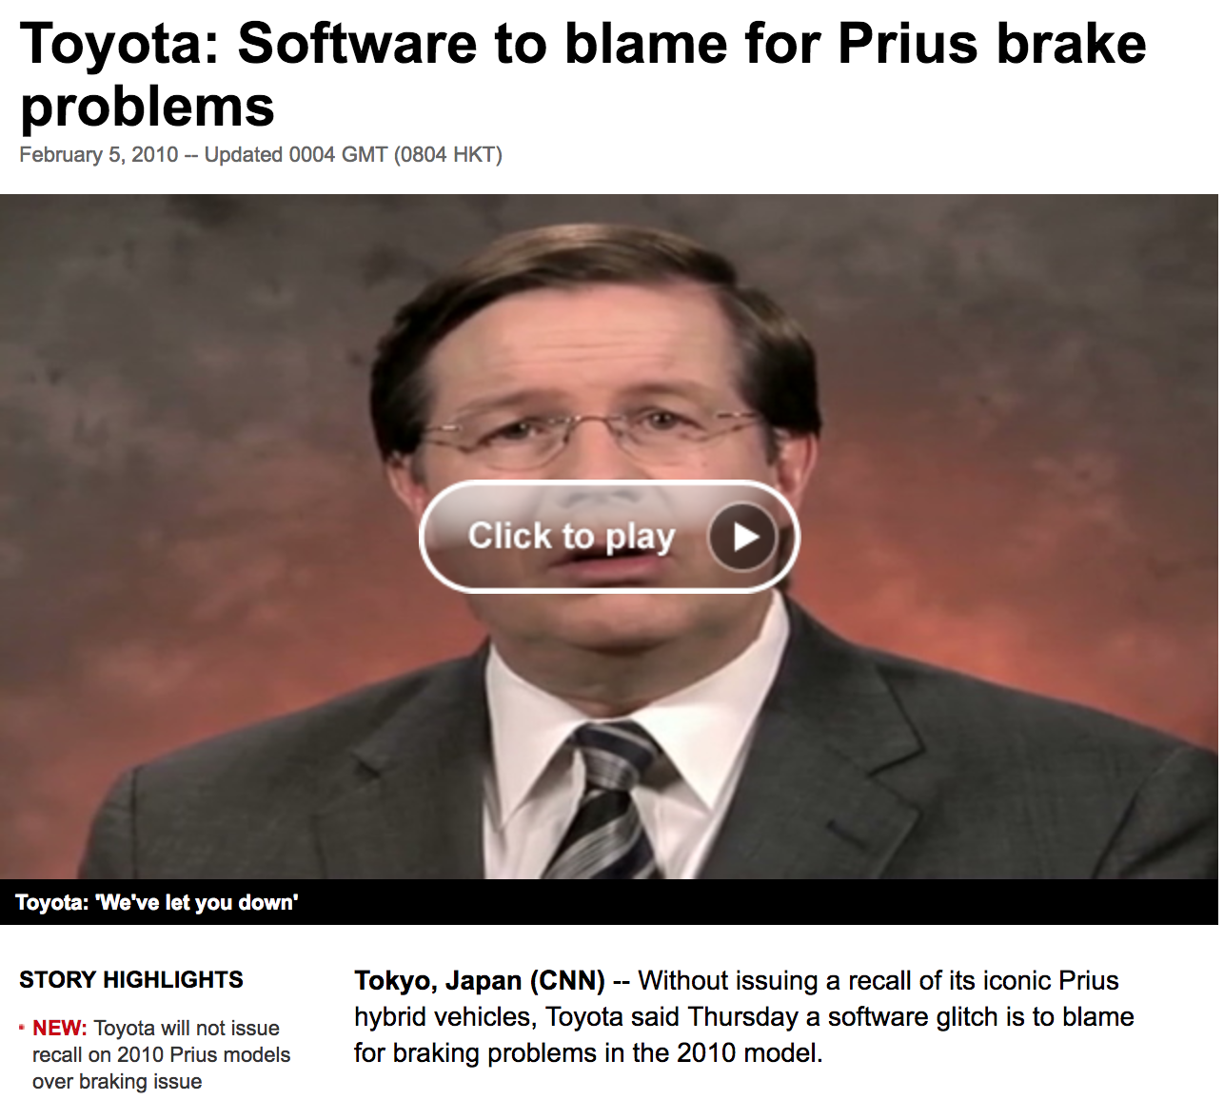
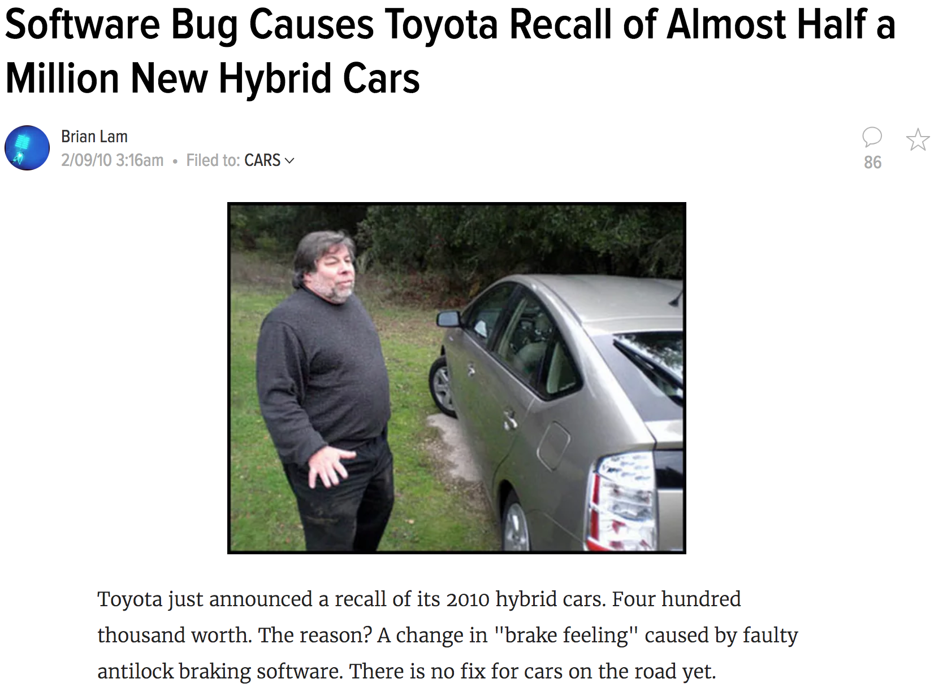

Slide 3
Testing does not suffice
“Program testing can be a very effective way to show the presence of bugs, but is hopelessly inadequate for showing their absence.“
Edsger W. Dijkstra

Slide 4
Adversarial Examples

Slide 5
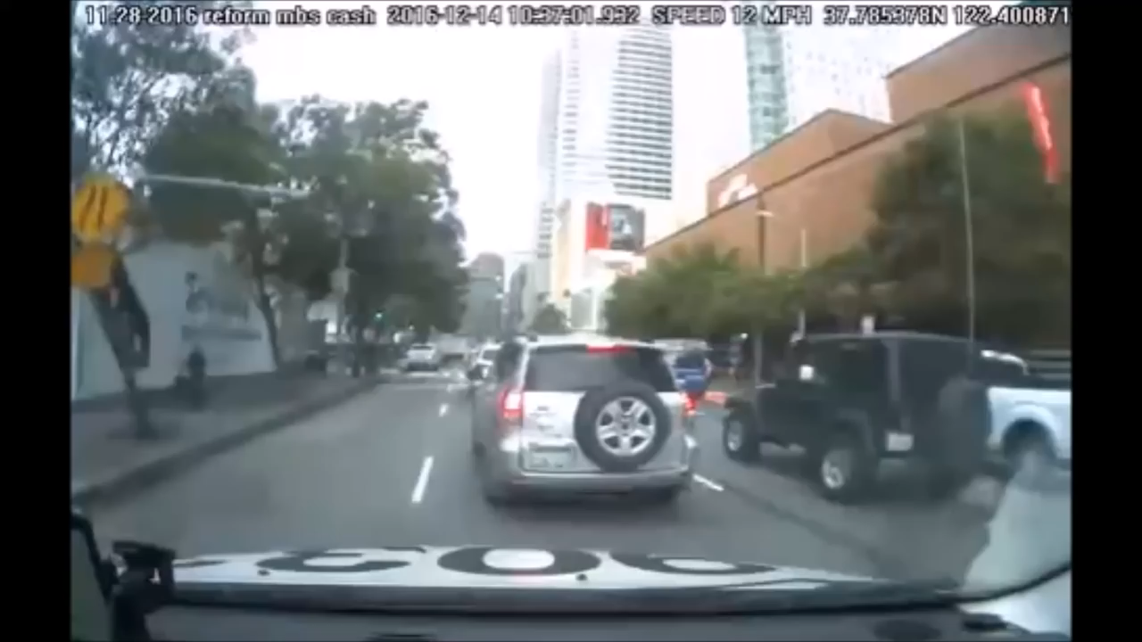
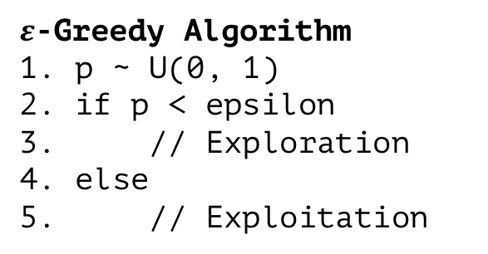
Safe Learning!
$ε$-Greedy Algorithm
1. p ~ U(0, 1)
2. if p < epsilon
3. // Exploration
4. else
5. // Exploitation
usually random action,
but this might damage
someone!

Slide 6
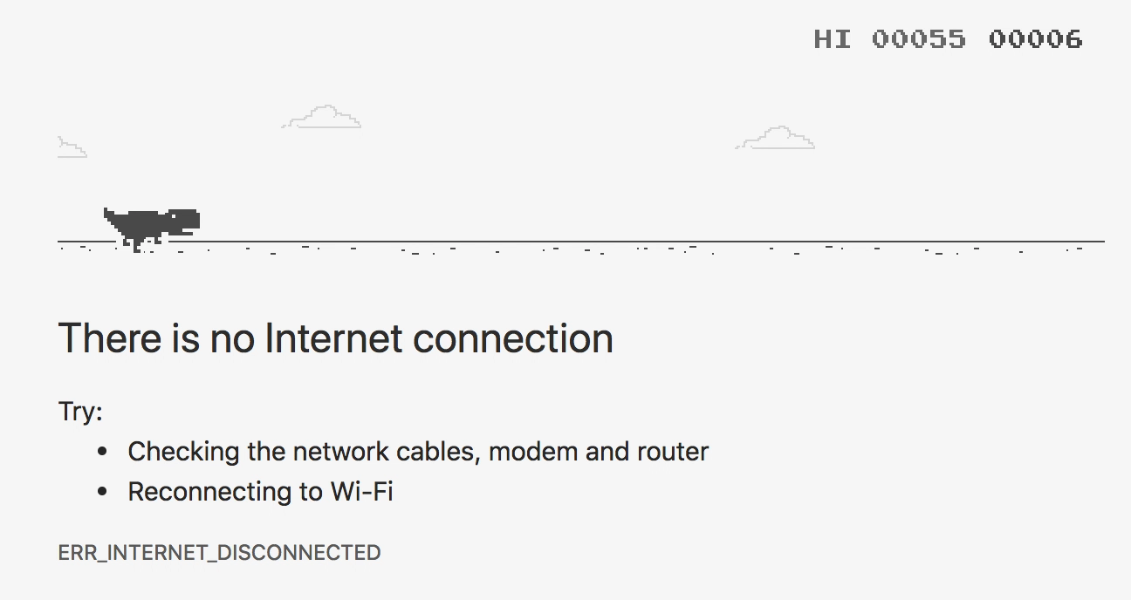
Accelerate Learning!

Slide 7
Approaches
Informal methods:
Avoid bugs:
Appropriate programming languages
Software engineering methods
Detect bugs:
Simulation, testing
Formal methods:
Prove absence of bugs:
Deductive methods
Program analysis
Detect bugs and prove their absence:
Model checking

Slide 8
Reinforcement Learning

Slide 9
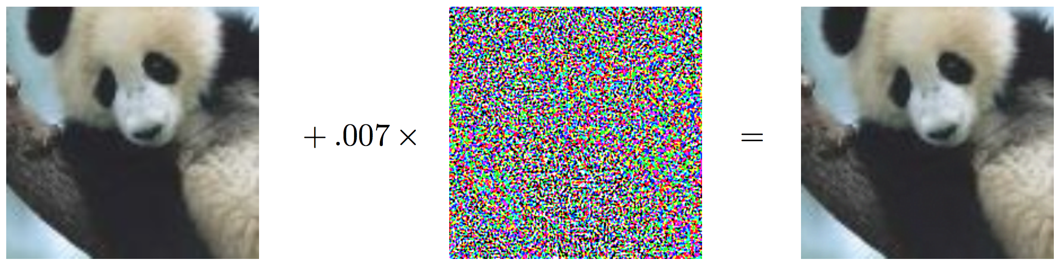
Adversarial Examples
“panda” 57.7% confidence
“gibbon” 99.3% confidence
Notes:
https://arxiv.org/pdf/1412.6572.pdf (2015)

Slide 10
Optimization vs Safety
Clever RL Algorithm
Problem
Optimized Policy
+
Theorem Solver
Specification
Safe Policy
Optimized and Safe Policy?

Slide 11
Topics
Why Formal Verification?
Assumptions in Machine Learning Algorithms
Verifiable Properties and Methods in RL
Problems and Open Questions

Slide 12
//Why Formal Verification?
Safety
Ensure that learning does not cause harm
esting does not suffice → Safety
Bugs can be prevented
Ensure that a (learned) policy ”works”
Already standard in many areas! (aviation)
ISO 26262
Faster learning:
During learning, unsafe policies are explored
poor initial performance → faster learning
Exploit domain knowledge
Cost Reduction
Find out about bugs early and be in a better position to fix them
Organizational matters
Certification processes
ISO 26262

Slide 13
Research Questions
Does Formal Verification make autonomous driving 100% safe?
How can we deal with uncertain situations?
How can we ensure that the model will always act in a safe way?

Slide 14
//Topics
Our Introduction
Why Formal Verification, Problems in RL, Motivation, Our Research Questions
Formal Verification in RL Simple Verification Example
Validation vs. Verification
Assumptions (Environment, Platform, Data, Algorithm)
Properties that can be verified (MDP, State to Action, …)
Methods
Verification of an MDP: Model Checking Action to Action Sequences: PRISM State to Action: Neural Networks (Reluplex)
Runtime Verification: JSCGeneric
(Verification of an Algorithm: SafeLyapunovLearning)
Problems and Open Question
Short summary, opinion, …
Notes:
Methoden:
Model verifiieren
NN
Online ..

Slide 15
Verifiable Properties and Methods in RL
RL
MDP
Optimized Policy
Does my MDP reflect the reality?
Will at least 95% of my runs end up in a good state?
TODO

Slide 16
Verifiable Properties and Methods in RL
Environment,
partial MDP
RL
Optimized Policy
Is my policy stable?
Can I ensure certain actions won’t happen in a specific state?
Can it deal with perturbations?

Slide 17
Verifiable Properties and Methods in RL
RL Implementation
1. if (p < 0.1) {
2. // do something
3. } else {
4. // do something else
5. }
Did I implement the code correctly?
RL
MDP
Optimized Policy
TODO: different type of specification

Slide 18
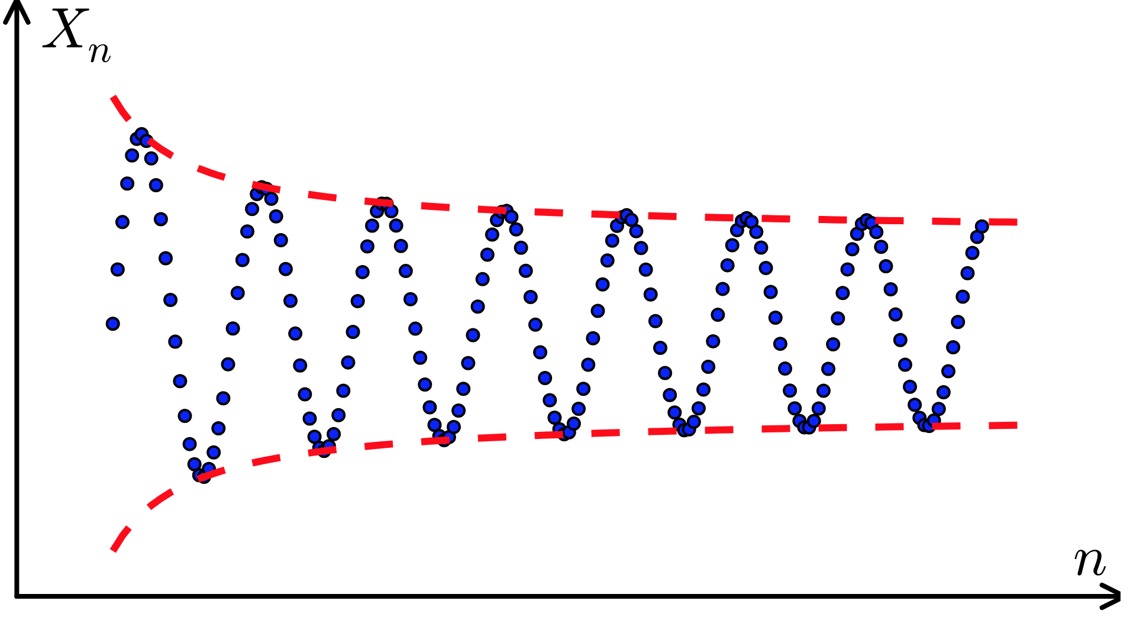
Verifiable Properties and Methods in RL
Will my algorithm converge?
RL
MDP
Optimized Policy

Slide 19
Runtime Verification
RL
Environment
Optimized Policy
Monitor
Specifications
Model
Guarantee only safe actions!
Can I accelerate the training?

Slide 20
What can be verified?
Offline: validate after learning
State to Action: Verify that a certain action will not happen in a given state
Action sequences (via PRISM)
Algorithm properties (e.g. convergence to a fix point)
Assumptions on Training Data (variable ranges, …)
Online: validate during learning
State to Action
Action sequences
Monitoring

Slide 22

State to Action Verification

Slide 23
State to Action Verification
verify that network still chooses the right action
even if sensor data is corrupt

Slide 24
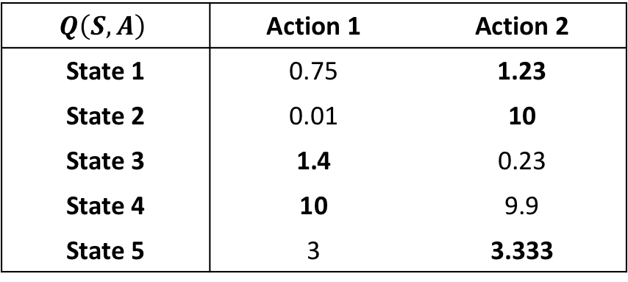
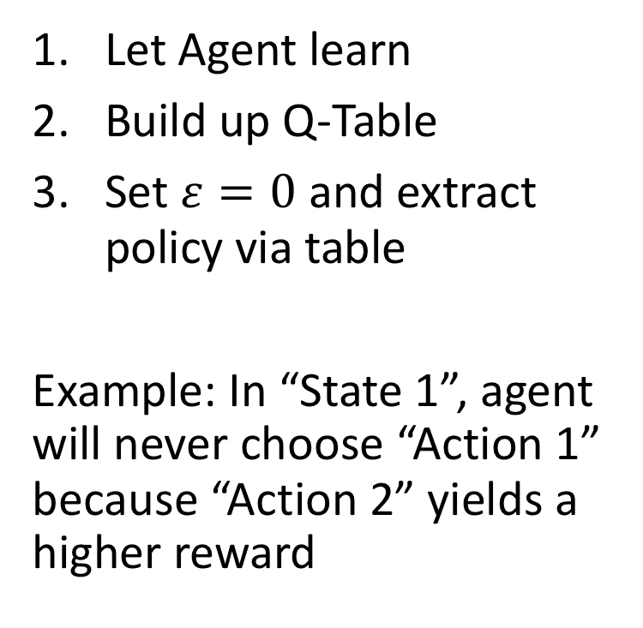
State to Action Verification in Q-Learning
$$Q\left(S, A\right)$$ | Action 1 | Action 2
State 1 | 0.75 | 1.23
State 2 | 0.01 | 10
State 3 | 1.4 | 0.23
State 4 | 10 | 9.9
State 5 | 3 | 3.333
Let Agent learn
Build up Q-Table
Set $ε=0$ and extract policy via table
Example: In “State 1”, agent will never choose “Action 1” because “Action 2” yields a higher reward
large / continuous

Slide 25
State to Action Verification in Q-Learning
$$Q\left(S, A\right)$$ | Action 1 | Action 2
State 1 | 0.75 | 1.23
State 2 | 0.01 | 10
State 3 | 1.4 | 0.23
State 4 | 10 | 9.9
State 5 | 3 | 3.333
Let Agent learn
Build up Q-Table
Set $ε=0$ and extract policy via table
Example: In “State 1”, agent will never choose “Action 1” because “Action 2” yields a higher reward
large / continuous

Slide 26
Function Approximation
non-linear
$$Q\left(S, A\right)$$ | Action 1 | Action 2
State 1 | 0.75 | 1.23
State 2 | 0.01 | 10
State 3 | 1.4 | 0.23
State 4 | 10 | 9.9
State 5 | 3 | 3.333
typically large

Slide 27
≥95% “panda”

Slide 28
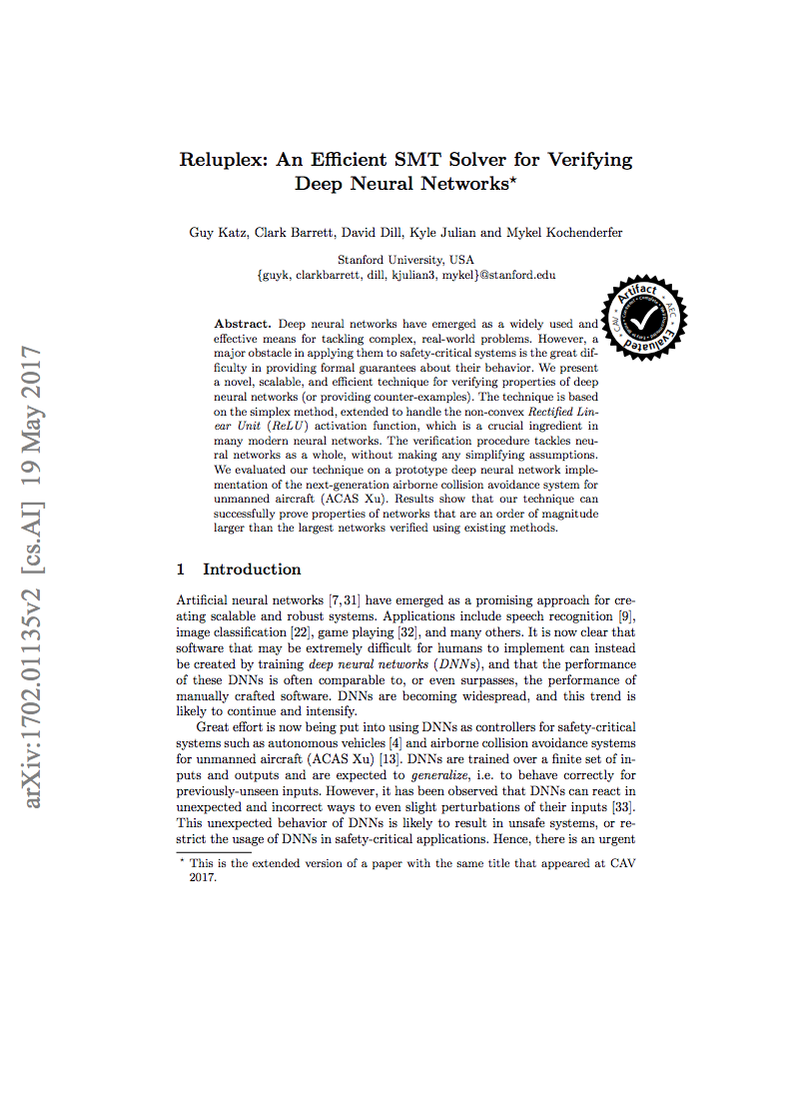
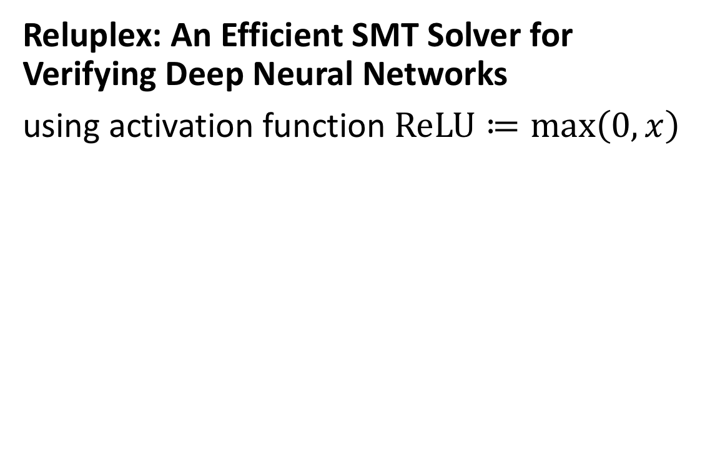
Reluplex: An Efficient SMT Solver for Verifying Deep Neural Networks
using activation function $ReLU≔\max\left(0,x\right)$
This makes it hard to verify

Slide 29
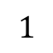
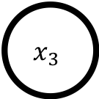
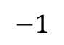
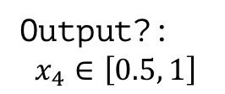

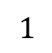
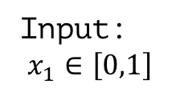
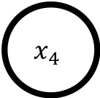
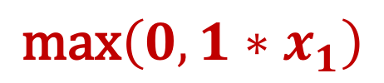
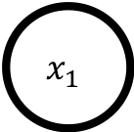
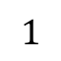
Simple Neural Network
$$\text{max}\left(0,1∗x_{1}\right)$$
$$x_{2}$$
$$1$$
$$1$$
Input:
$$x_{1}∈\left[0,1\right]$$
$$x_{1}$$
$$x_{4}$$
Output?:
$$x_{4}∈\left[0.5, 1\right]$$
$$−1$$
$$x_{3}$$
$$1$$

Slide 30
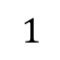

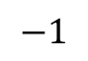
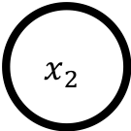
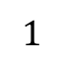
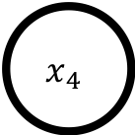

Simple Neural Network
$$x_{2}$$
$$1$$
$$1$$
$$x_{1}$$
$$x_{4}$$
$$−1$$
$$x_{3}$$
$$1$$

Slide 32
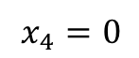
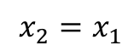
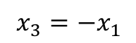
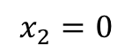
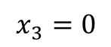
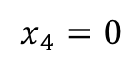
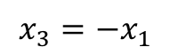
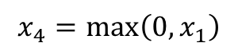
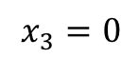
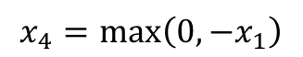
Case Splitting to make it linear
$$x_{2}=0$$
$$x_{2}=x_{1}$$
$$x_{3}=0$$
$$x_{3}=−x_{1}$$
$$x_{3}=0$$
$$x_{3}=−x_{1}$$
$$x_{4}=0$$
$$x_{4}=\text{max}\left(0, −x_{1}\right)$$
$$x_{4}=\max\left(0, x_{1}\right)$$
$$x_{4}=0$$

Slide 33
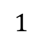
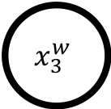
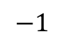
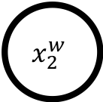
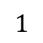

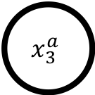
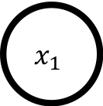
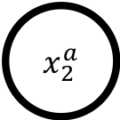
$$x_{2}^{w}$$
ReLU
$x_{2}^{a}$
$$1$$
$$1$$
$$x_{1}$$
$$x_{4}$$
$$−1$$
$$x_{3}^{w}$$
ReLU
$$x_{3}^{a}$$
$$1$$

Slide 34
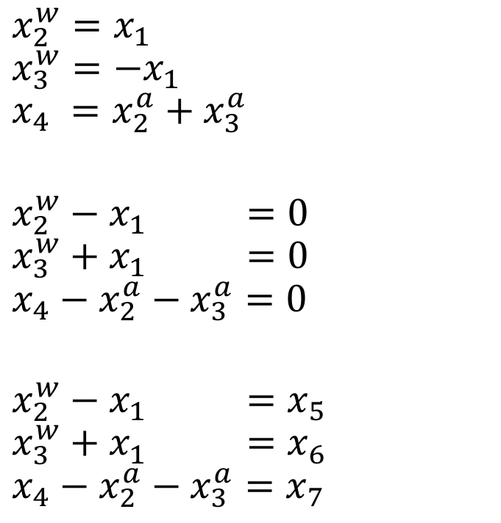
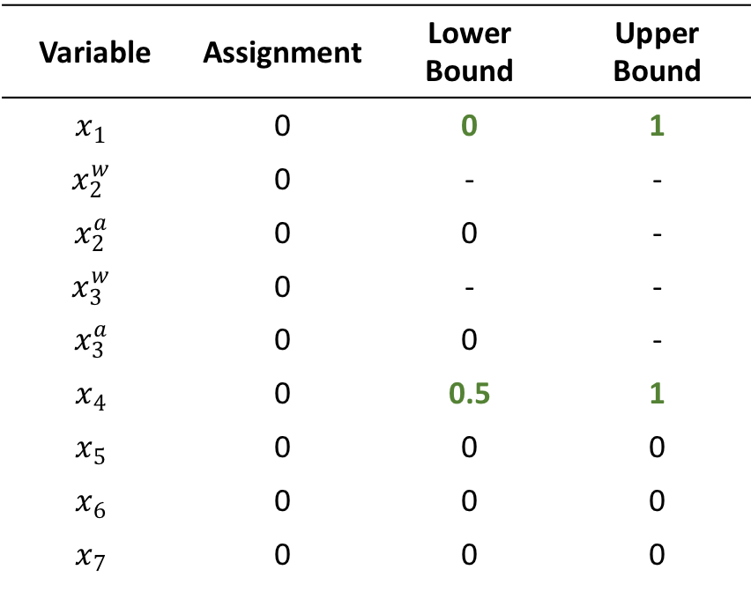
Example
Variable | Assignment | Lower Bound | Upper Bound
$$x_{1}$$ | 0 | 0 | 1
$$x_{2}^{w}$$ | 0 | - | -
$$x_{2}^{a}$$ | 0 | 0 | -
$$x_{3}^{w}$$ | 0 | - | -
$$x_{3}^{a}$$ | 0 | 0 | -
$$x_{4}$$ | 0 | 0.5 | 1
$$x_{5}$$ | 0 | 0 | 0
$$x_{6}$$ | 0 | 0 | 0
$$x_{7}$$ | 0 | 0 | 0
$$x_{2}^{w}=x_{1}$$
$$x_{3}^{w}=−x_{1}$$
$$x_{4} =x_{2}^{a}+x_{3}^{a}$$
$$x_{2}^{w}−x_{1} =0$$
$$x_{3}^{w}+x_{1} =0$$
$$x_{4}−x_{2}^{a}−x_{3}^{a}=0$$
$$x_{2}^{w}−x_{1} =x_{5}$$
$$x_{3}^{w}+x_{1} =x_{6}$$
$$x_{4}−x_{2}^{a}−x_{3}^{a}=x_{7}$$

Slide 35
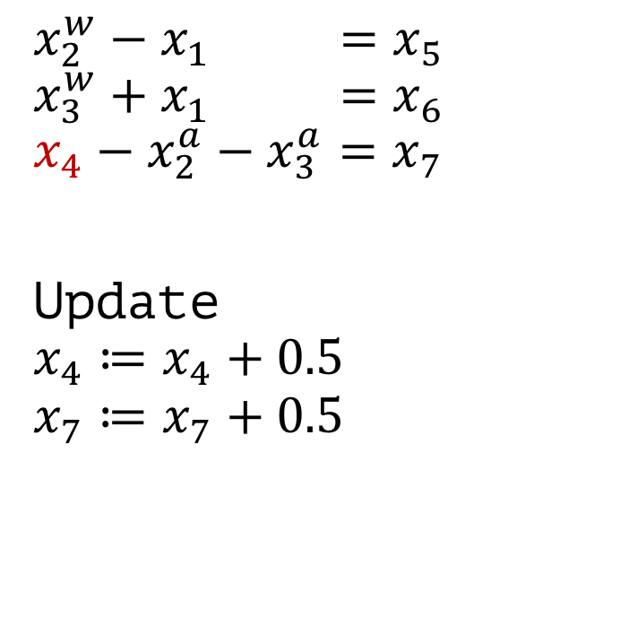
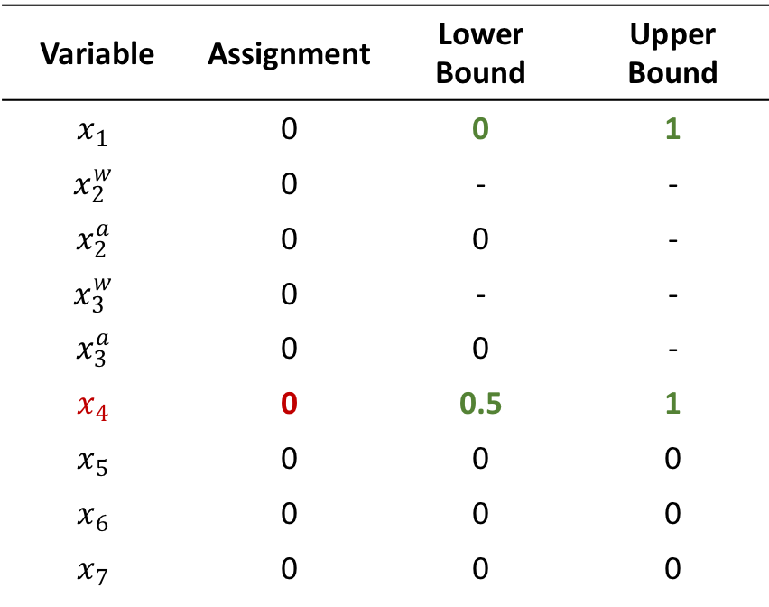
Example
Variable | Assignment | Lower Bound | Upper Bound
$$x_{1}$$ | 0 | 0 | 1
$$x_{2}^{w}$$ | 0 | - | -
$$x_{2}^{a}$$ | 0 | 0 | -
$$x_{3}^{w}$$ | 0 | - | -
$$x_{3}^{a}$$ | 0 | 0 | -
$$x_{4}$$ | 0 | 0.5 | 1
$$x_{5}$$ | 0 | 0 | 0
$$x_{6}$$ | 0 | 0 | 0
$$x_{7}$$ | 0 | 0 | 0
$$x_{2}^{w}−x_{1} =x_{5}$$
$$x_{3}^{w}+x_{1} =x_{6}$$
$$x_{4}−x_{2}^{a}−x_{3}^{a}=x_{7}$$
Update $$x_{4}≔x_{4}+0.5$$
$$x_{7}≔x_{7}+0.5$$

Slide 36
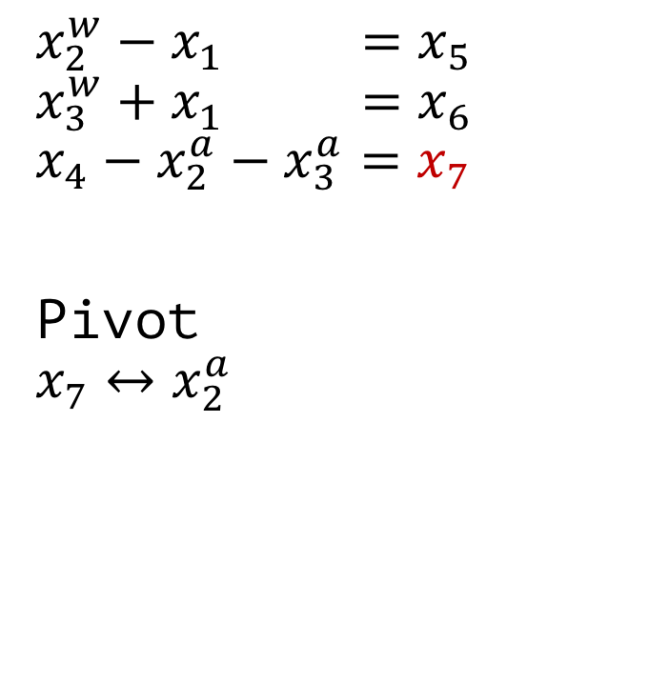

Example
Variable | Assignment | Lower Bound | Upper Bound
$$x_{1}$$ | 0 | 0 | 1
$$x_{2}^{w}$$ | 0 | - | -
$$x_{2}^{a}$$ | 0 | 0 | -
$$x_{3}^{w}$$ | 0 | - | -
$$x_{3}^{a}$$ | 0 | 0 | -
$$x_{4}$$ | 0.5 | 0.5 | 1
$$x_{5}$$ | 0 | 0 | 0
$$x_{6}$$ | 0 | 0 | 0
$$x_{7}$$ | 0.5 | 0 | 0
$$x_{2}^{w}−x_{1} =x_{5}$$
$$x_{3}^{w}+x_{1} =x_{6}$$
$$x_{4}−x_{2}^{a}−x_{3}^{a}=x_{7}$$
Pivot $$x_{7}↔x_{2}^{a}$$

Slide 37


Example
Variable | Assignment | Lower Bound | Upper Bound
$$x_{1}$$ | 0 | 0 | 1
$$x_{2}^{w}$$ | 0 | - | -
$$x_{2}^{a}$$ | 0 | 0 | -
$$x_{3}^{w}$$ | 0 | - | -
$$x_{3}^{a}$$ | 0 | 0 | -
$$x_{4}$$ | 0.5 | 0.5 | 1
$$x_{5}$$ | 0 | 0 | 0
$$x_{6}$$ | 0 | 0 | 0
$$x_{7}$$ | 0.5 | 0 | 0
$$x_{2}^{w}−x_{1} =x_{5}$$
$$x_{3}^{w}+x_{1} =x_{6}$$
$$x_{4}−x_{7}−{ x}_{3}^{a} =x_{2}^{a}$$
Update $$x_{7}≔x_{7}−0.5$$
$x_{2}^{a}≔x_{2}^{a}+0.5$

Slide 38


Example
Variable | Assignment | Lower Bound | Upper Bound
$$x_{1}$$ | 0 | 0 | 1
$$x_{2}^{w}$$ | 0 | - | -
$$x_{2}^{a}$$ | 0.5 | 0 | -
$$x_{3}^{w}$$ | 0 | - | -
$$x_{3}^{a}$$ | 0 | 0 | -
$$x_{4}$$ | 0.5 | 0.5 | 1
$$x_{5}$$ | 0 | 0 | 0
$$x_{6}$$ | 0 | 0 | 0
$$x_{7}$$ | 0 | 0 | 0
$$x_{2}^{w}−x_{1} =x_{5}$$
$$x_{3}^{w}+x_{1} =x_{6}$$
$$x_{4}−x_{7}−{ x}_{3}^{a} =x_{2}^{a}$$
Update $$x_{2}^{w}≔x_{2}^{w}+0.5$$
$$x_{5}≔x_{5}+0.5$$

Slide 39


Example
Variable | Assignment | Lower Bound | Upper Bound
$$x_{1}$$ | 0 | 0 | 1
$$x_{2}^{w}$$ | 0.5 | - | -
$$x_{2}^{a}$$ | 0.5 | 0 | -
$$x_{3}^{w}$$ | 0 | - | -
$$x_{3}^{a}$$ | 0 | 0 | -
$$x_{4}$$ | 0.5 | 0.5 | 1
$$x_{5}$$ | 0.5 | 0 | 0
$$x_{6}$$ | 0 | 0 | 0
$$x_{7}$$ | 0 | 0 | 0
$$x_{2}^{w}−x_{1} =x_{5}$$
$$x_{3}^{w}+x_{1} =x_{6}$$
$$x_{4}−x_{7}−{ x}_{3}^{a} =x_{2}^{a}$$

Slide 40


Final Result
Variable | Assignment | Lower Bound | Upper Bound
$$x_{1}$$ | 0.5 | 0 | 1
$$x_{2}^{w}$$ | 0.5 | - | -
$$x_{2}^{a}$$ | 0.5 | 0 | -
$$x_{3}^{w}$$ | -0.5 | - | -
$$x_{3}^{a}$$ | 0 | 0 | -
$$x_{4}$$ | 0.5 | 0.5 | 1
$$x_{5}$$ | 0 | 0 | 0
$$x_{6}$$ | 0 | 0 | 0
$$x_{7}$$ | 0 | 0 | 0
$$x_{2}^{w}−x_{1} =x_{5}$$
$$x_{3}^{w}+x_{1} =x_{6}$$
$$x_{4}−x_{7}−{ x}_{3}^{a} =x_{2}^{a}$$
This assignment solves the equation
”If $x_{1}∈\left[0,1\right]$ then $x_{4}∈\left[0.5, 1\right]$”

Slide 41
Problems
Infinite Loop → Case Splitting
Implementation
How to define neighborhood of an image?
Noise?
Missing data?
What about other activation functions?
Needs to be linear
Approximation

Slide 42

Safe Reinforcement Learning via Formal Methods (2018)
Idea: Optimize a safe controller using RL
Explore through safe actions only
Use RL to solve optimization problem
Requirement
Controller that performs provable safe actions
(Physical) model of the reality

Slide 43

Differential Dynamic Logic $dℒ$
Hybrid program
precondition
postcondition

Slide 44



Hybrid Program $α$
Repeat arbitrary times
Controller
Either accelerate with $A$ or break
Model differential equations describe behavior
Either choose $a≔A$ or $a≔0$

Slide 45

Offline Verification
Verify offline that hybrid program $α$ performs safe actions

Slide 46

Full specification $dℒ$ formula
If our car moves forward with non-negative velocity
after choosing actions, it still has a non-negative velocity

Slide 47

Formula Transformations
Controller Monitor
What are our safe actions?
$$dℒ$$
ModelPlex
Model Monitor
Does our Model comply with the reality?

Slide 48


Controller Monitor $CM$
Input: Current State $s$, Action $a$
Output: True / False
Task: Check if performing action $a$ in state $s$ is safe according to our hybrid program $α$.

Slide 49

Controller Monitor Example
performing act() will not change path or velocity
ModelPlex
$$v_{\text{post}}=\text{act}\left(v_{\text{pre}}\right)$$
v_curr
p_curr
a_curr
act()
v_post = act(v_curr); p_post = act(p_curr); a_post = act(a_curr)
return (v_post == v AND p_post == p AND a_post == A) OR (v_post == v AND p_post == p AND a_post == 0);
True
False

Slide 50

Controller Monitor
KeYmaera X Theorem Solver
v_post = act(v_curr); p_post = act(p_curr); a_post = act(a_curr)
return (v_post == v AND p_post == p AND a_post == A) OR (v_post == v AND p_post == p AND a_post == 0);
Check if post-state can be reached by pre-state
$$v_{\text{post}}=\text{act}\left(v_{\text{pre}}\right)$$

Slide 51







Model Monitor
Is our Model accurate? Can our new state be explained by the model?
Model Monitor $MM:S × A × S→\left\{\text{True}\text{, }\text{False}\right\}$
Action 1: $a≔A$
Action 2: $a≔0$
$$v_{\text{pre}}$$
$$v_{\text{post}}=\text{act}\left(v_{\text{pre}}\right)$$
(expected by the model)
$$v_{\text{real}}$$
(observed)

Slide 52


Model Monitor $MM$
Input: previous state $s$, current state $\tilde{s}$
Output: True / False
Task: Is there a transition from the previous state $s$ to the current state $\tilde{s}$ that can be explained by the model?

Slide 53
Controller Monitor Example
ModelPlex
return t_post >= 0 AND
a_post == A AND
v_post == A*t_post + v_prev AND
p_post == A*t_post^2 / 2 + v_prev*t_post + p_pre) OR
t_post >= 0 AND
a_post == 0 AND
v_post == v_pre AND
p_post == v_pos*t_post + p_pre

Slide 54
Algorithm
1. JSCGeneric(init, (S,A,R,E), choose, update, done, CM, MM) {
2. prev := curr := init;
3. a0 := NOP;
4. while (!done(curr)) {
5. if (MM(prev, curr)) {
6. u := choose({a ∈ A | CM(a, curr)});
7. } else {
8. u := choose(A);
9. }
10. prev := curr;
11. curr := E(u, prev);
12. update(prev, u, curr);
13. }
14. }
// or do something more clever (ask expert, …)

Slide 55

ModelPlex
Input: verified $dℒ$ formula $φ→\left[α^{∗}\right]ψ$
Output: (simpler) arithmetic formula
Task: Rewrite $dℒ$ formula Apply Theorem Proving until nothing can be done anymore

Slide 56


ModelPlex
Calculation Rules
Automatic Reasoning

Slide 57
Model might not reflect reality due to
Sensor errors
Mechanics malfunctions
Wrong (too simple) assumptions which do not hold in real life

Slide 58

Applying Formal Methods to Reinforcement Learning (2018)
Learn from demonstrations
Problem 1: Agent may encounter unseen situations
Solution: Dataset-Aggregation
Problem 2: Generate “expert” trajectories automatically
Solution: Reward function synthesis using formal methods.

Slide 59
//Proposed Method
Name some ideas?
Advantages and disadvantages
Boost safe method with formal verification
Show that a certain approach does not work
...

Slide 60
Does it make 100% fail prove?
Specification might incomplete / wrong
Assumptions might be violated
Alignment Problem (see spam example)
Numeric errors → verification of the implementation
Domain knowledge might be wrong
Model might not reflect reality
Constraints are hard to come up with
Probabilities
(or not considered!)
Continuity of dynamics, i.i.d., …
Formal Verification of “pure” program code is not possible (undecidable)

Slide 61
Open Questions and Problems

